Slide 1
Portfolio Overview
JOSIAH MANNING

Slide 2

CSCI Department Website (unofficial)
Worked on a scrum team to build a website from scratch using Agile methods, with intuitive UI, fillable forms, and server-side MySQL database.
My JavaScript functions use AJAX to pass JSON strings to PHP with inline MySQL queries to modify the server database with phpMyAdmin.
Full presentation: https://drive.google.com/open?id=1Zn6Hj_nmFo_l1XtnwJskWBhY2HQRzzZ8ODmR7ilSrfo
(note slides 9, 10, and 21, which demonstrate my diagrams, code, and the resulting pages)

Slide 3
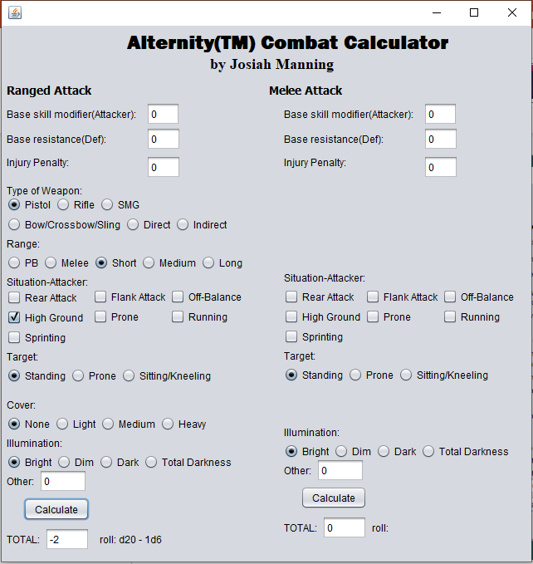
Alternity Combat Calculator
Fun personal project
Built for the 1999 Alternity pen-and-paper roleplaying game by TSR
Improves combat flow by providing quick calculations
Built in NetBeans using Java Swing
Uses effective UI/UX for easy usability
Github link: https://github.com/jtvanilla1/Alternity-Combat-Calculator

Slide 4
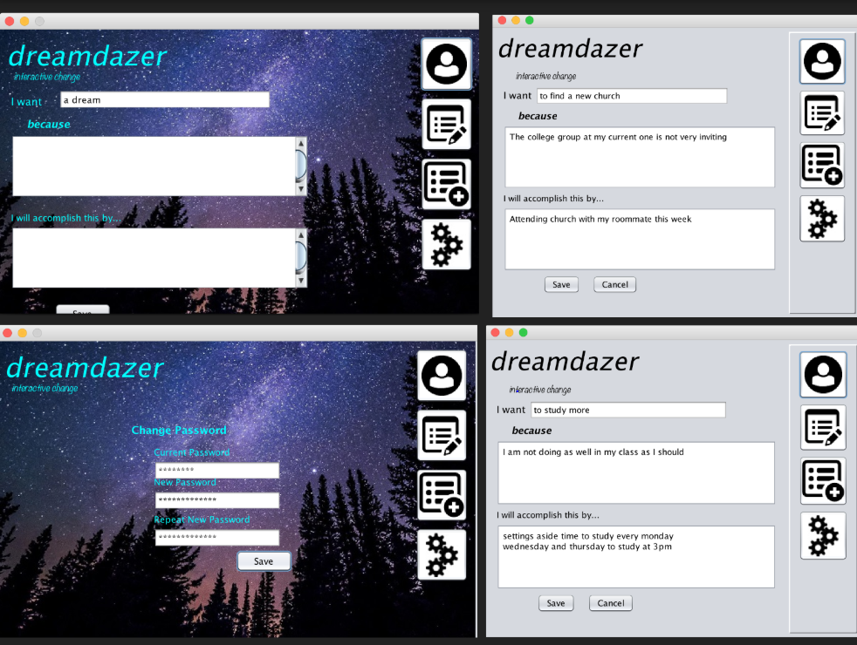
DreamDazer UI
Multi-page UI
Built in NetBeans with Java Swing, on a team of 4
No back-end functionality; only UI and front-end UI functions
I was in charge of quality control, such as page dimension and design consistency, as well as transition functions.
Full presentation: https://drive.google.com/open?id=1yv5S7tzyNuj0evWClWWo29cD8bUu_iWV

Slide 5
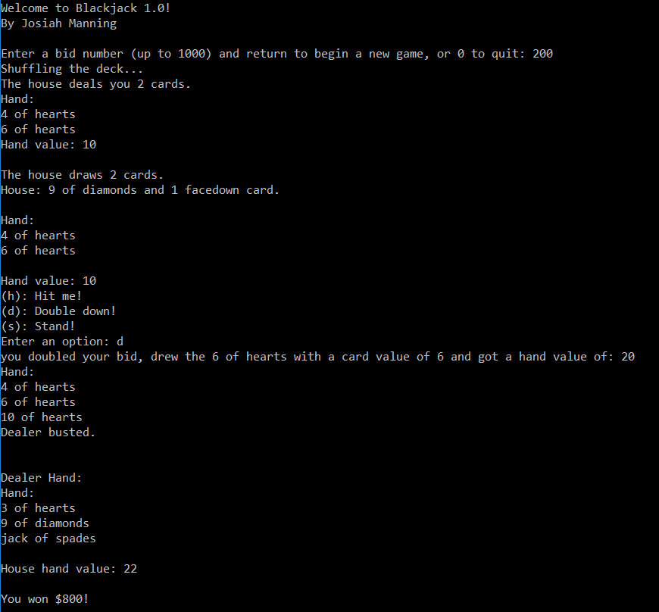
Blackjack
Fun personal project
Object-Oriented C++ text-based blackjack playing cards simulator
RNG deck generator and shuffler
Implements blackjack rules as detailed by Bicycle.com
Recursive play function in the event of a split
Github link: https://github.com/jtvanilla1/blackjack

Slide 6
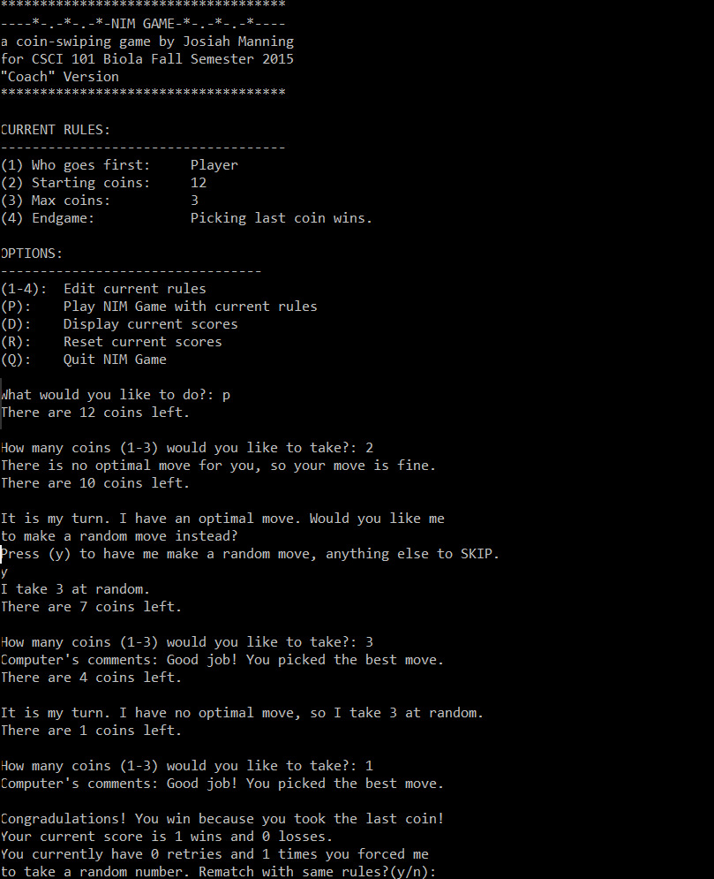
Nim Game
Based on the Dr. Nim game by Hasbro
Rules options
Memory-based scorekeeping
Stack structure
Coaching mode gives insight into choices made
Computer makes optimal choices except when forced to make random moves.
Github link: https://github.com/jtvanilla1/Nim-Game/blob/master/nimgame.cpp

Slide 7
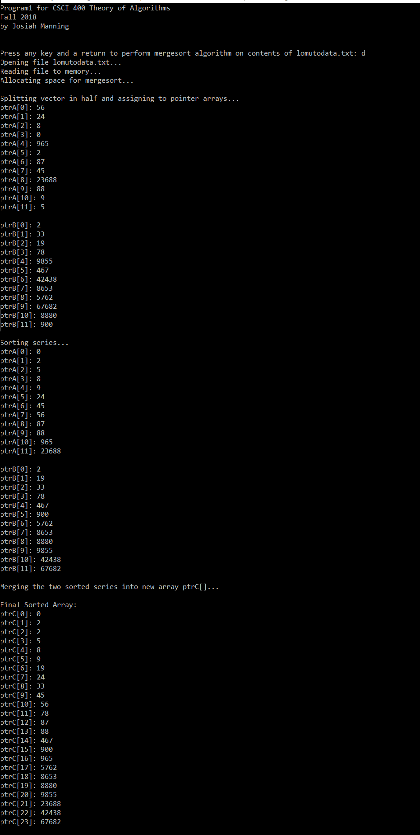
Merge Sort
Reads unsorted data from file
Sorts data using the merge sort algorithm
Print sorting steps at each iteration
Implements recursive programming
Github link: https://github.com/jtvanilla1/merge-sort/blob/master/mergesort.cpp

Slide 8
Tic-Tac-Toe vs. Minimax Alpha-Beta
Play Tic-Tac-Toe against an AI
Uses the minimax and alpha-beta algorithms to determine moves.
Github link: https://github.com/jtvanilla1/Tic-Tac-Toe-Minimax-AI/blob/master/TicTacToeMinimaxAI.cpp

Slide 9
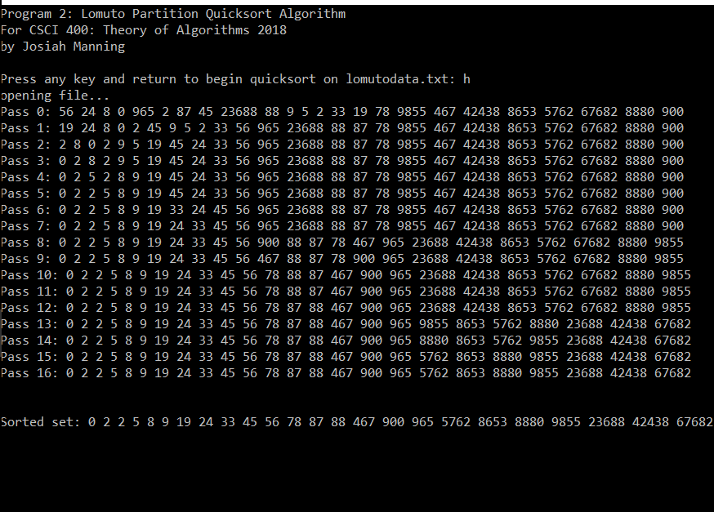
Lomuto Partition QuickSort
Reads unsorted numbers from file
Sorts unsorted numbers using QuickSort with Lomuto’s partition algorithm
Recursively picks a pivot index and puts all smaller values to the left and all greater values to the right.
Github link: https://github.com/jtvanilla1/Quicksort-Lomuto-Partition/blob/master/lomutoPartitionQuicksort.cpp

Slide 10
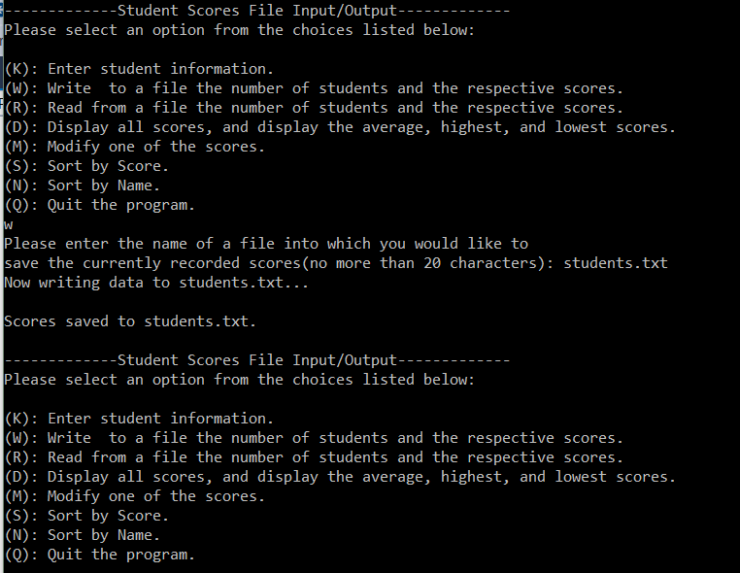
Student Scores I/O and Calculator
Enter information, save to file
Read from file
Edit memory
Alphanumeric select sorting
Github link: https://github.com/jtvanilla1/Student-Scores-IO/blob/master/studentScoresIO.cpp

Slide 11
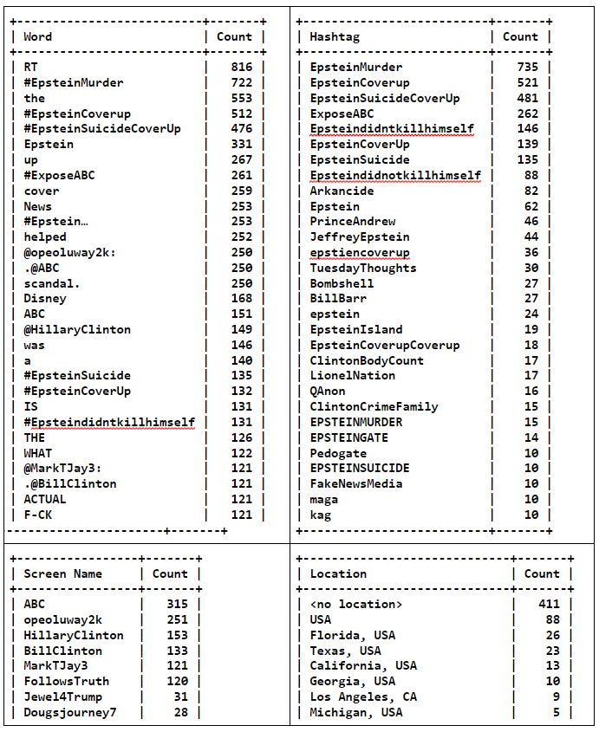
Senior Thesis Project:
Twitter API Data Mining
Python script mines Twitter’s Search API for word counts, screen names, related hashtags, and locations related to the #epsteinmurder hashtag.
Normalizes common spelling variances between tweets
Further explained in senior thesis paper: https://drive.google.com/open?id=1c3Iv8KoBpAmzYQqPE719mvwHQYuLyF7xe0aEOG26xgw
Github link: https://github.com/jtvanilla1/Twitter-API-hashtag-mining/blob/master/twitterEpsteinMiner.py

Slide 12
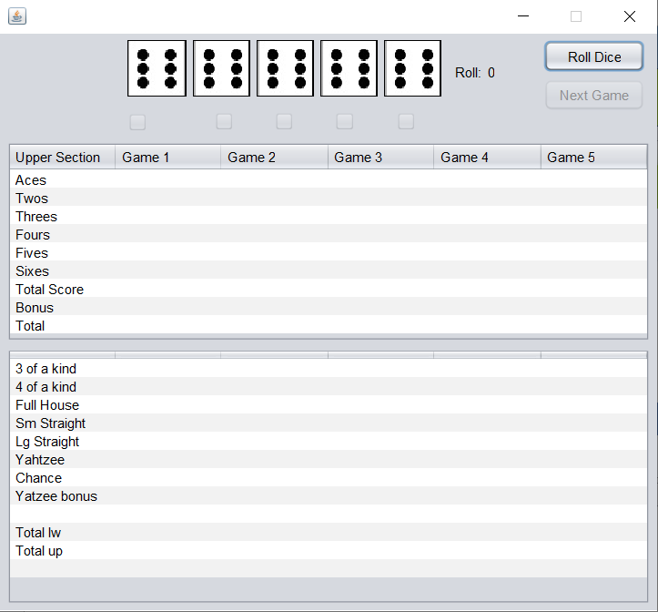
Yatzee
Fun personal project.
Java-based Yatzee program currently in development with Netbeans, as of March 2020.
Currently supports RNG die rolling, die holds, and restricted UX/UI for scoring control.
Automatic score tables, score selection, and updated UI planned in later pushes.
Github link: https://github.com/jtvanilla1/Yatzee/tree/master/yatzee/src/yatzee1

Slide 13
Thank you.

